Slide 1
Robotic Manipulator
Kartik Sah

Slide 2
Overview
To develop a general n-revolute robotic arm class in python.
To implement the theory of kinematics, velocity analysis, dynamics, PID controller, and trajectory generation - Mark Spong.
Solve inverse kinematics using Deep Neural Network, as there is no general solution to solve for inverse kinematics of a non-intersecting wrist arm.
Programming done based on OOPs methodology.

Slide 3
Structure of the overall Schema
PID/PI class
Trajectory Planning
Forward Kinematics
Path Planning
Robotic Arm class
Inverse Kinematics
DC/BLDC Motor Dynamics

Slide 4

Robotic Arm Class
To initialize a Robotic Manipulator
One can set the Number of joints, and assign DH parameters to initialize a robotic manipulator.

Slide 5

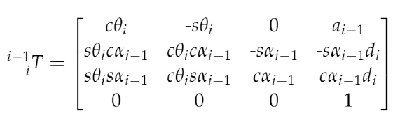
Inverse and Forward Kinematics Class
Forward Kinematics:
Input: Angular Position/Angular Velocity to the joints
Output: x,y,z coordinates of the links
Implemented by computing the transformation matrices (which transform from )
Inverse Kinematics:
Input: x,y,z coordinates of the final link
Output: Angular Position/Angular Velocity to the joints

Slide 6
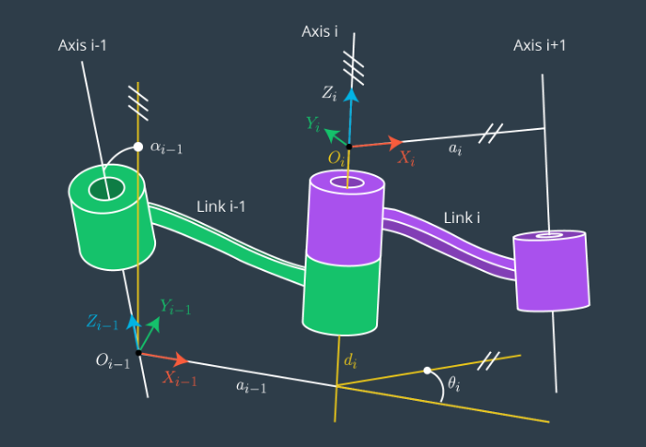
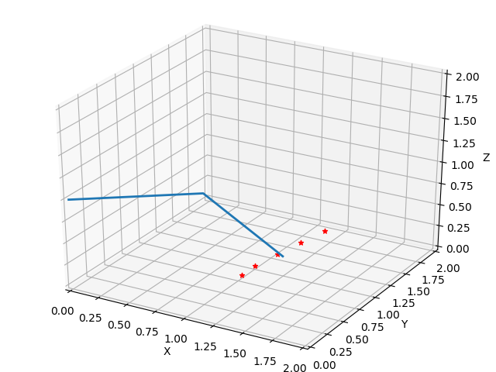
Target Coordinates

Slide 7
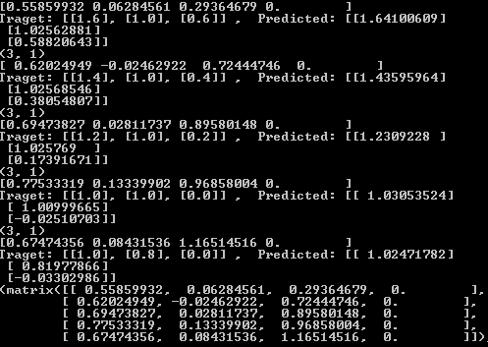
Code Results
Inverse Kinematics using Gradient Descent
Learning Rate : 0.2
Error Tolerance : 0.05

Slide 8
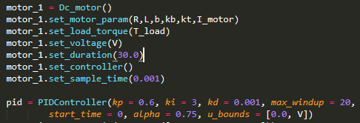
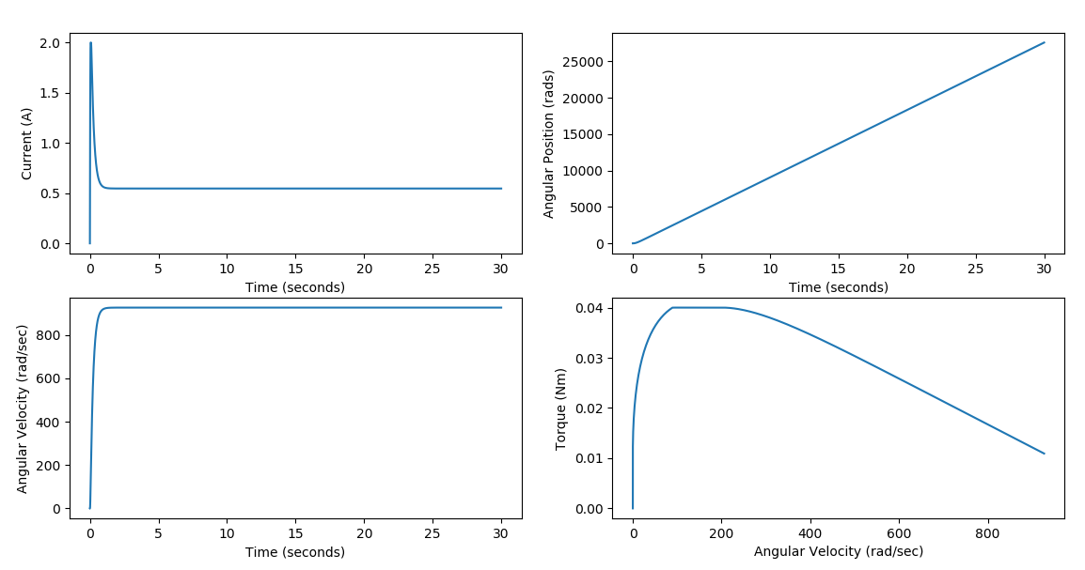
DC Motor Class
Generalized class for DC motor
Plots

Slide 9
Trajectory Planning
Use Linear Parabolic blend to form a continuous trajectory connecting the discrete points.
Path Planning module will provide discrete points(Based on some algorithm A*, RRT, etc.)
Using the above points as inputs, along with the required time between two points, and the acceleration required.
Example:
Discrete Points = 10,1000,3000,4000,3000 radian
Time = 10,10,10,10
Acceleration = 40,35,60,50,50

Slide 10
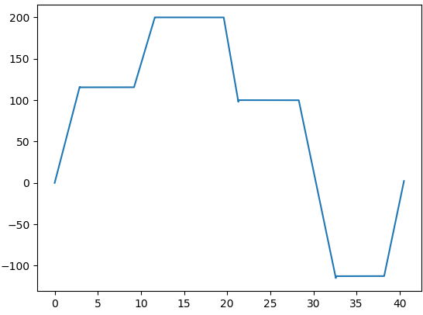
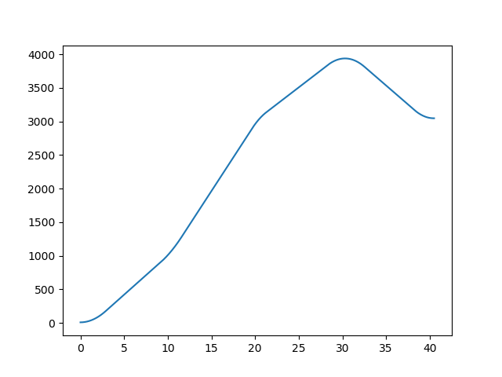
Generated Trajectory as per LPSB
Angular Velocity
Time (Seconds)
Angular Position
Time (Seconds)

Slide 11
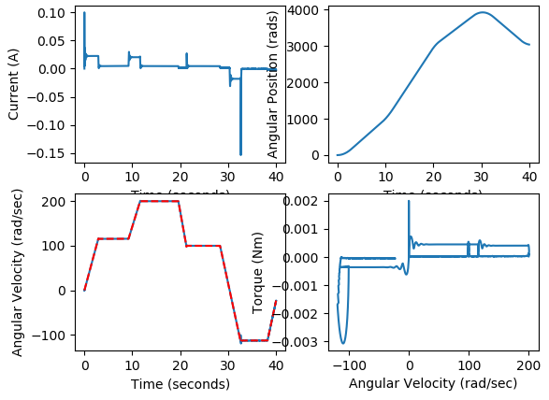
PID Controller
To make the Manipulator follow the generated trajectory, we feed the controller the reference trajectory and the controller regulates the Voltage to make the manipulator follow the desired trajectory.
Assumptions: Independent Joint control
Gain are currently selected through trial and error. Gain and Phase margin plot needed for better selection of gains.
Red line is the desired trajectory

Slide 12
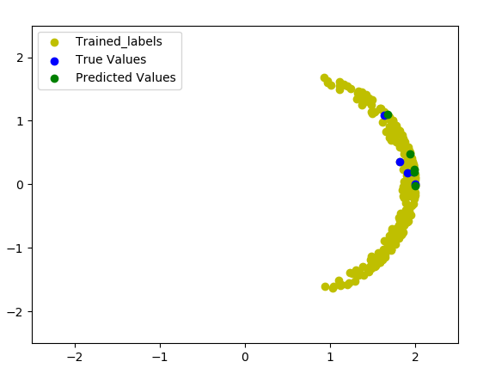
Neural Network for Inverse Kinematics
To avoid the process of gradient descent every time, another method is to use neural networks to learn the inverse kinematics.
Advantages are fast computation when the function is learned
Disadvantages, currently is that point with multiple solution.
Y
X

